Slide 1
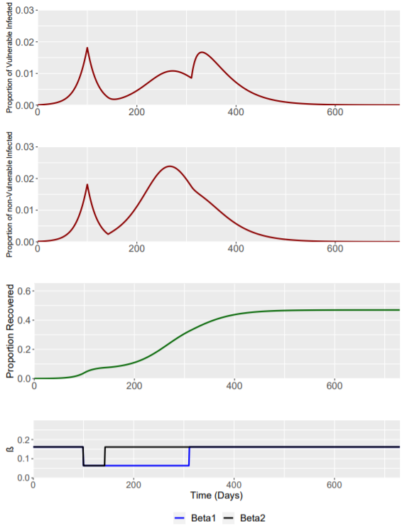
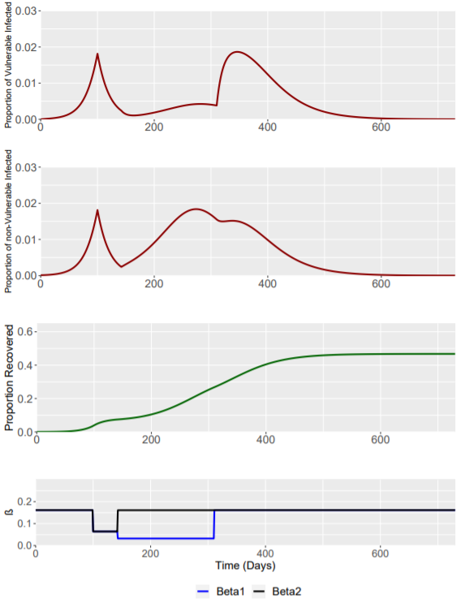
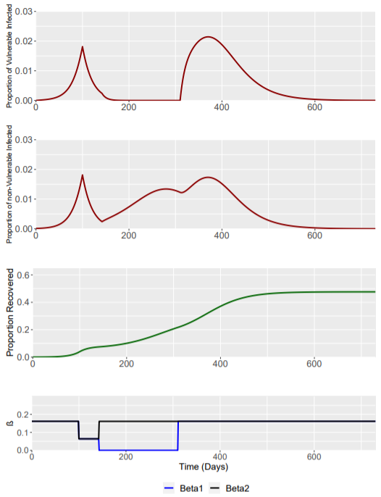
BASELINE
Phase | Weeks | Beta1 | Beta2
0 | Up to t=0 | 0.161 | 0.161
1 | 0-6 | 0.064 | 0.064
2 | 6-30 | 0.064 | 0.161
3 | 30 onwards | 0.161 | 0.161
Phase | Weeks | Beta1 | Beta2
0 | Up to t=0 | 0.161 | 0.161
1 | 0-6 | 0.064 | 0.064
2 | 6-30 | 0.032 | 0.161
3 | 30 onwards | 0.161 | 0.161
Phase | Weeks | Beta1 | Beta2
0 | Up to t=0 | 0.161 | 0.161
1 | 0-6 | 0.064 | 0.064
2 | 6-30 | 0 | 0.161
3 | 30 onwards | 0.161 | 0.161

Slide 2
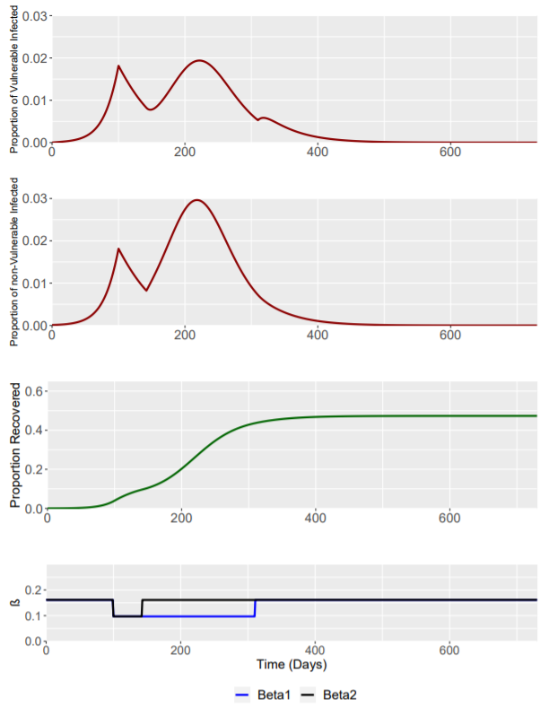
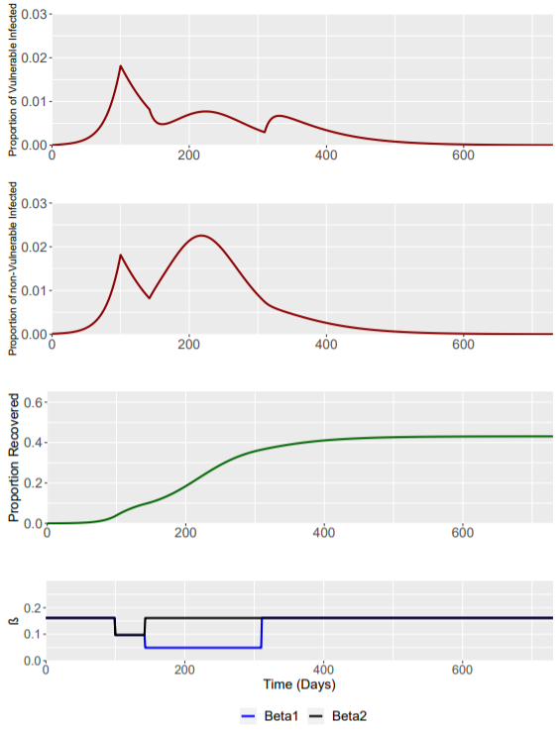
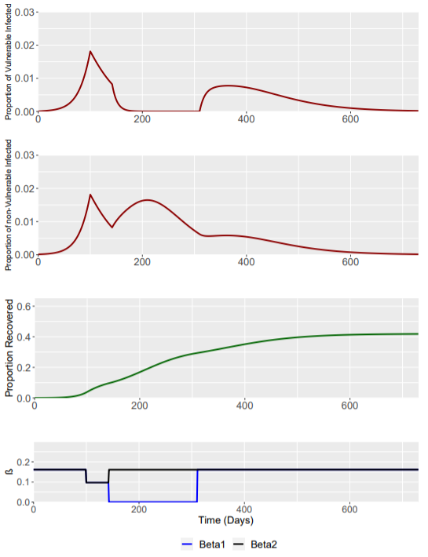
RWC
Phase | Weeks | Beta1 | Beta2
0 | Up to t=0 | 0.161 | 0.161
1 | 0-6 | 0.097 | 0.097
2 | 6-30 | 0.097 | 0.161
3 | 30 onwards | 0.161 | 0.161
Phase | Weeks | Beta1 | Beta2
0 | Up to t=0 | 0.161 | 0.161
1 | 0-6 | 0.097 | 0.097
2 | 6-30 | 0.049 | 0.161
3 | 30 onwards | 0.161 | 0.161
Phase | Weeks | Beta1 | Beta2
0 | Up to t=0 | 0.161 | 0.161
1 | 0-6 | 0.097 | 0.097
2 | 6-30 | 0 | 0.161
3 | 30 onwards | 0.161 | 0.161

